Slide 1

Using Variable Precision
DSP Block and Designing with Floating Point
Technology Roadshow 2011
1.1

Slide 2
Agenda
Variable Precision DSP Architecture in Altera 28-nm FPGA
Floating-point Processing with 28-nm Variable Precision DSP

Slide 3
Variable-Precision DSP Architecture
Notes:
For questions or comments, please contact Michael Parker, DSP Marketing

Slide 4
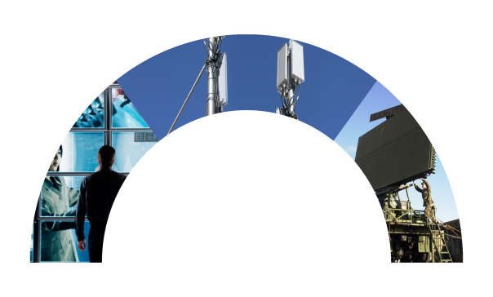
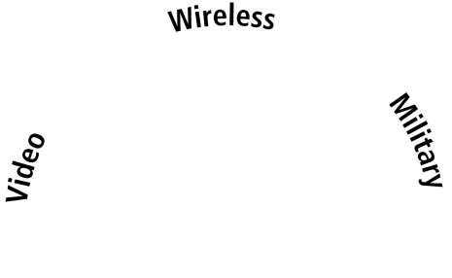
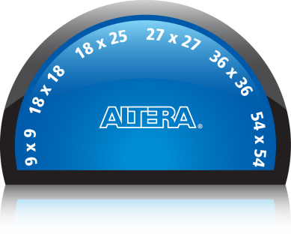

Industry’s First Variable-Precision DSP Block
Set the Precision Dial to Match Your Application
4
Notes:
4
Signal processing applications increasingly demand not only higher performance but also higher precision – and indeed different precision levels make sense at different stages of the signal processing data paths. For example, video broadcast applications can use multipliers ranging from 9x9 to all the way up to 18x18. Other applications such as wireless and medical systems push the precision needs even further as they develop complex, multi-channel filters with the need to maintain data precision after each stage of the filter. Then there are applications within the military, test and high-performance computing industries that push the envelope in terms of both performance and precision – sometimes even requiring the need for single/double precision floating point precision when implementing complex matrix operations and FFTs.
Altera architected the industry’s first variable-precision DSP block. While this block is backward compatible with all the existing modes supported by our 65-nm and 40-nm devices, it adds native, efficient support for a range of higher precision modes. A single ‘variable precision DSP block’ @28nm can support precision ranging from 9x9 to all the way up to 27x27.
Also the DSP blocks are designed to be cascaded with the widest, dedicated cascade bus in the industry – 64 bits. This allows the building of DSP data paths of even higher precision – up to 54x54 – in the most efficient manner with maximum performance.
The variable precision DSP block is designed to enable the most silicon efficient implementation of your signal processing chain. It is the industry’s only DSP block architecture to feature a configurable 18/26 pre-adder, a 64-bit accumulator + cascade bus and an internal co-efficient storage – all designed to allow the most area efficient implementation of common functions such as FIR filters, FFTs and floating point.
Calculation:
The DSP Block can run at 500 MHz.
GMACS (Giga Multiply-Accumulate Operations Per Second) 3680*500 = 1,800 GMACS (1,840 GMACS using 18x18 multipliers)
GFLOPS (Giga Floating-Point Operations Per second) 1840*500 = 1 TFLOPS (920 GFLOPS using two 18x18 multipliers)
One floating point operation = a single precision floating point mantissa multiplier which is done using a 27x27 multiplier
So a Stratix V 730 which has 1840 DSP Blocks (each of which can be configured in a 27x27 mode) generates 1840x500 = 920 GFLOPs

Slide 5
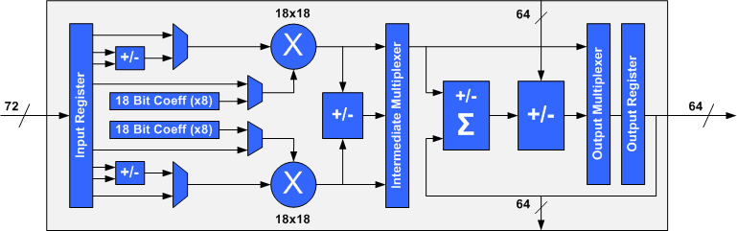
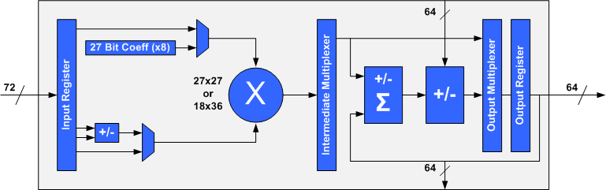
Variable-Precision DSP Block
28nm HP
18-Bit Precision Mode
Built-In Pre-Adders
64-Bit Accumulator
and Cascade Bus
Built-In
Coefficient Register Banks
Dual 18x18 or One 27x27 / 18x36
Multipliers
High-Precision Mode
Notes:
Many additional features are incorporated into both modes. There are hard pre-adders (or subtractors), internal 8 deep coefficient register banks, 64 bit accumulator, and 64 bit internal cascade bus between DSP blocks.

Slide 6
Variable Precision Features for FIR & FFT
28nm HP
‘Variable Precision’ Features For FIR/FFT | ADVANTAGE
Hard pre-adder (18 bits or 26 bits) | Implements symmetric FIR filters using half the multiplier resources
Internal co-efficient register bank | Implements FIR filters using fewer registers and produces higher f_{MAX}
Dual 18x18, OR one 18x36, OR one 18x25 | Implements FFTs with up to half the number of DSP blocks
64 Bit Accumulator & Cascade Adder | High precision cascade capability for FFTs
Saving logic resources effectively gives you a larger device,
compared to competing technologies
Notes:
The Hard pre-adder can be configured for 18 or 26 bits. For symmetric filters, this allows you to do the addition stage before multiplication, which cuts your required multiplier count in half.
The internal coefficient register bank allows for higher multiplier performance by keeping the functionality contained within the DSP block. This coefficient bank can be configured as either dual 18bit wide register banks, each capable of storing eight coefficients per multiplier, or in high precision mode, can be configured as a single 27bit wide register bank capable of again storing eight coefficients per multiplier. This avoids delays associated with the general logic interconnect. In addition, for large multiplier counts, this also saves a considerable amount of general registers, that can then be used for other functionality. This essentially makes the effective logic size of our devices larger than competing technologies that do not have internal coefficient banks.
Each “Variable Precision” DSP Block can be implemented as a pair of 18x18 multipliers, or a single 18x36 or 27x27 high precision block. This variable precision capability, which can be set on a block by block basis, allows the designer to implement many DSP functions using only one “Variable Precision” DSP Block.
Our 64bit accumulator and cascade adder allows the designer to carry a higher level of precision between DSP blocks when creating DSP functions that require more than one DSP block, compared to other competing technologies, which provide up to 48bits for this functionality.

Slide 7
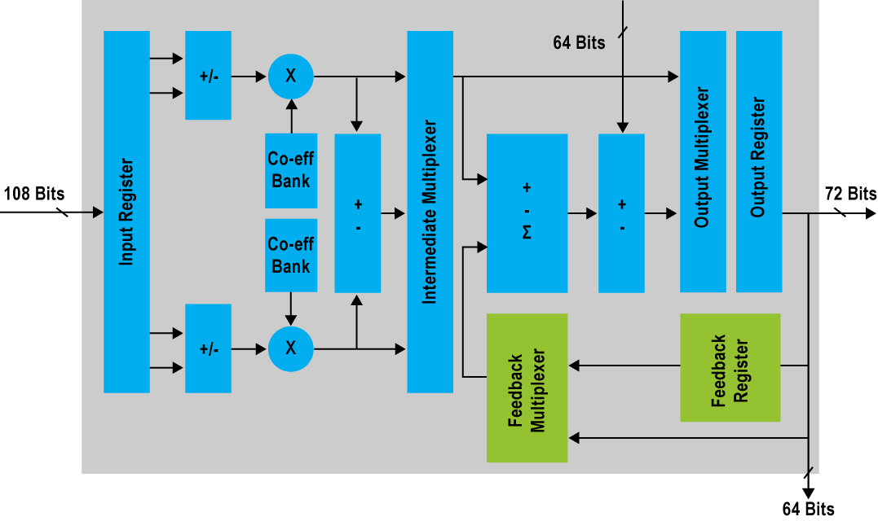
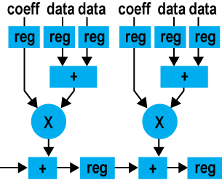
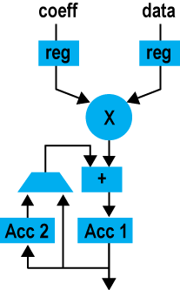
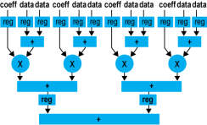
Arria-V/Cyclone-V: Variable-Precision DSP Block Enhanced for FIR Implementation
28nm LP
64-Bit Cascade Path
Supports systolic finite impulse response (FIR)
Performs sum-of-products operations
Multiplier Modes for Flexibility
Three 9x9 multipliers, or
Two 18x18 multipliers, or
One 27x27 multiplier per block
Up to 64-Bit Adder/ Subtractor/Accumulator
1,024-tap filters
2,048-tap symmetric filters
Integrated Coefficient Registers
Save memory and routing resources
Provide built-in timing closure
Feedback Register and Multiplexer
Implement two independent filter channels per DSP block
Hard Pre-Adders
Reduce multiplier usage
Save routing resources
New for Arria V/Cyclone V
FPGAs
Systolic FIR
Direct FIR
Serial FIR
High-Efficiency FIR Filter Implementation

Slide 8

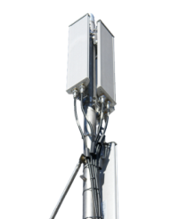

Key Applications
28nm LP
64-Bit Cascade Path
Supports systolic finite impulse response (FIR)
Performs sum-of-products operations
Multiplier Modes for Flexibility
Three 9x9 multipliers, or
Two 18x18 multipliers, or
One 27x27 multiplier per block
Up to 64-Bit Adder/ Subtractor/Accumulator
1,024-tap filters
2,048-tap symmetric filters
Integrated Coefficient Registers
Save memory and routing resources
Provide built-in timing closure
Feedback Register and Multiplexer
Implement two independent filter channels per DSP block
Hard Pre-Adders
Reduce multiplier usage
Save routing resources
New for Arria V/Cyclone V
FPGAs
Motion control
Wireless
FIR
Video
processing
High-Efficiency for Key Applications

Slide 9
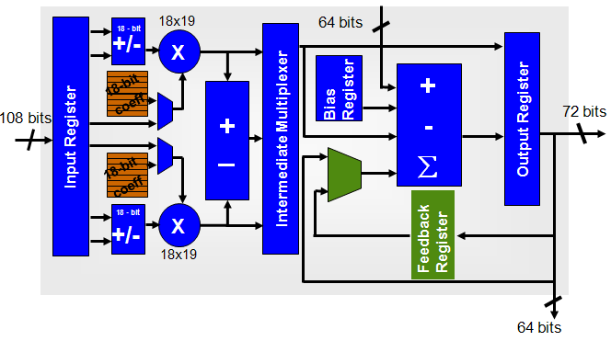
28nm HP and 28nm LP Comparison
28nm HP
28nm LP
Notes:
It contains two basic configurations – 18 bit and high precision. 18 bit mode has two multipliers per block. High precision mode has one multiplier per block.

Slide 10
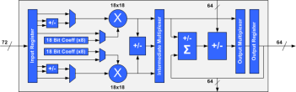
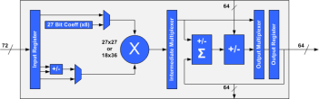
Variable-Precision with
64-Bit Cascade Bus
28nm
18-Bit Precision Mode
High-Precision Mode
Notes:
Multiple DSP blocks can be used to build many high precision DSP functions.

Slide 11
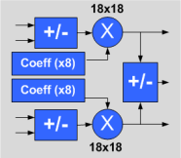
Hard Pre-Adder for Filters
28nm
D₃
D₂
D₁
D₀
D₃
D₂
D₀
D₁
+
+
C0
C1
C1
C0
C0
C1
X
X
X
X
X
X
+
+
+
+
Pre-Adder Reduces Multiplier Count by Half
Notes:
As is commonly understood, pre-adders are primarily used for symmetric FIR filters. As the filter data is shifted across the coefficient set, two data samples can be multiplied by a common coefficient due to the symmetry. The pre-adder adds the two samples prior to multiplication, which allows the use of one multiplier for every two taps, rather than two multipliers.
A pre-adder can be used to cut multiplier use by ½ for symmetric FIR filters or at least eliminates the need to implement such a adder stage in logic – increasing both logic efficiency and performance. Stratix V DSP block includes a hard pre-adder that can be configured as either dual 18 bit or a single 26 bit pre-adder, depending upon the precision mode. One restriction in 18 bit mode is that use of the hard 18 bit pre-adder requires also using the internal coefficient banks, due to input port limitations. The designer should try to arrange the filter designs to use a maximum of eight coefficients per multiplier, to take advantage of both of these features. In general, try to build a single large multi-channel filter, as opposed to several single channel filters, which will reduce coefficients per multiplier for any given filter response length.

Slide 12
Harden Internal Co-efficient Register Banks
28nm
18-bits
27-bits
0
0
1
1
2
2
3
OR
3
4
4
5
5
6
6
7
7
Dual, independent 18-bit or single 27-bit wide banks
Both are eight registers deep
Dynamic, independent register addressing
Eases timing closure and eliminates external registers
Enough coefficients for most parallel systolic multi-channel FIR filters
Notes:
The internal co-eff register storage feature that is unique to Altera can be set to support both 18-bit and higher than 18-bit precision signal processing. In the 18-bit mode, the co-eff storage is configured as dual 18-bit wide register banks – each capable of storing eight co-eff per multiplier. In the high-precision mode the co-eff storage is configured as a single 27-bit wide register bank capable of again storing eight co-eff per multiplie.
The primary advantage of internal (to the DSP block) co-eff storage is that it ease timing closure and saves on the on-chip memory/register resource usage – which are the two more important chip resources for DSP intensive designs.
Every clock cycle – you can dynamically select which of the eight registers should be used as a co-eff for the multiplier

Slide 13
Harden Biased Rounding Block
28nm LP
Example 1
44.2
+ 0.5
= 44.7
After truncation
= 44
Example 2
44.6
+ 0.5
= 45.1
After truncation
= 45
Step 1: Add 0.5
Step 2: Truncate
Simplest rounding method, has hardware support in Variable Precision DSP Block
Notes:
This method will produce correct rounded result after truncation. It is called “biased, because a number from X.00 to x.49 will be rounded down, and X.50 to X.99 will be rounded up. To have unbiased, X.50 should have equal chance of rounding either up or down, since it is precisely in the middle.
For most arithmetic, this slight “bias” is not important, and biased rounding is used because of it’s simplicity

Slide 14
Systolic Parallel Filter Mode (1/2)
28nm HP
18-bit precision mode, using pre-adder and internal coefficient
17 Bits
18x18
44 Bits
18 Bits
+/-
X
+
17 Bits
18-Bit
Coeff
Systolic Register
Input Register
+
18-Bit
Coeff
17 Bits
18 Bits
X
Output Register
44 Bits
+/-
18x18
17 Bits
44 Bits
Notes:
Systolic FIR filters use a distributed output adder, requiring an adder and register stage for each multiplier. By integrating this in the DSP block, no external logic is required for this function (compared with direct form FIR filters, which require an adder tree following the multiplier stages). The Variable Precision DSP block uses both 18x18 multipliers in systolic mode. In this mode, a 44 bit cascade bus is used, which provides 8 bits of bit growth relative to the 36 bit products, allowing 256 multipliers to be used without any worry about overflow. As shown, the pre-adder and coefficient registers can be also used in this mode.

Slide 15
Systolic Parallel Filter Mode (2/2)
28nm HP
High-precision mode, using pre-adder and internal coefficient
22 Bits
64 Bits
X
27x27
Input Register
+
27-Bit
Coeff
25 Bits
25 Bits
Output Register
+/-
64 Bits
25 Bits
64 Bits
Notes:
Systolic FIR filters can also be implemented in the high precision mode. In this case, full 64 bit cascade path is used, which provides 10 bits of bit growth relative to the 54 bit products, allowing 1024 multipliers to be used without any worry about overflow. As shown, the pre-adder and coefficient registers can be also used in this mode.

Slide 16
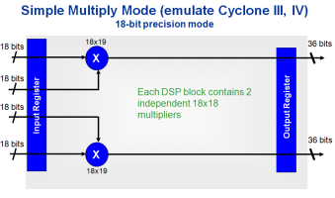
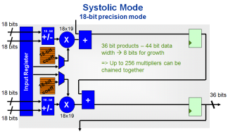
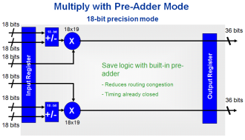
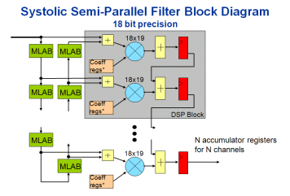
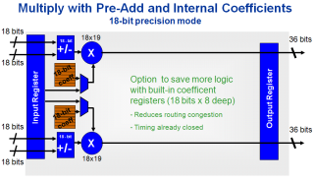
Example DSP Mode: Systolic FIR
28nm LP
Example: Utilize pre-adder and built in coefficient in Systolic FIR
Save logic
minimize
cost & power

Slide 17
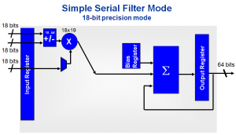
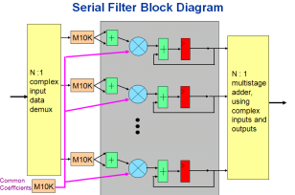
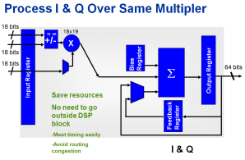
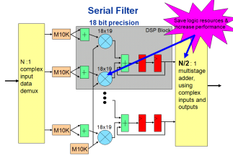
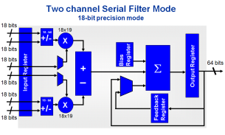
Example DSP Mode: Serial Filter
28nm LP
Example: Half the output adder tree in a serial filter
Save logic
minimize
cost & power

Slide 18
Floating Point DSP Architecture
Notes:
For questions or comments, please contact Michael Parker, DSP Marketing

Slide 19
Floating-Point Multiplier Resources
Floating-point density is largely determined by hard multiplier density
  Multipliers must efficiently support floating-point mantissa sizes
3.2x
1.4x
6.4x
4x
1.4x
19
Notes:
As we will see, floating point processing rates are limited by multiplier resources. Altera multiplier densities have been progressively increasing with each successive family. However, note how the single precision multiplier density has increased over six times from Stratix IV to Stratix V, and offers the highest single precision FPGA multiplier density per die.

Slide 20
New Floating-Point Methodology
Processors – each FP operation in standardized IEEE754 format
This can be done but not optimized
in FPGAs
  Excessive logic usage
  Unsustainable routing requirements
  Sub 100-MHz performance
  This penalty discourages use of FP
  compared to fixed
Altera has novel approach:
fused datapath
  IEEE754 interface only at algorithm boundaries
  Large reduction in logic and routing
  Optimize algorithms to use hard multipliers
  Single and double-precision floating-
  point support
  Based upon internal C to datapath tool
Notes:
We need to consider the IEEE754 floating point standard, used by CPUs. It is not well suited for FPGAs, and using this approach will lead to poor performance, and excessive routing and logic usage.
Instead, Fused Datapath support IEEE754 only at the functional boundaries. Within a functions or datapath, the circuit design is optimized, which results in a “fusing” of various floating point operations.
Some specific optimizations:
Use two’s complement for mantissa representation, which is hardware efficient
Minimize normalization requirements, by using extended length mantissas
Use multipliers rather than barrel shifters where normalization is required

Slide 21
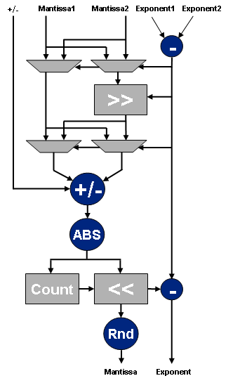
New Floating-Point Implementation
Slightly Larger – Wider
Operands
Denormalize
True Floating Mantissa
(not just 1.0 – 1.99..)
Normalize
Remove
Normalization
Do Not Apply Special and Error Conditions Here
Notes:
Here we can see these optimizations in a few more details. IEEE754 mantissas are 23 bits (single precision), are unsigned, and have an explicit one implied (from 1.0 to 1.999). This is replaced by standard signed two’s complement number of 27 or 36 bits (we can expand the mantissa width since this is configurable logic), and we can use 27x27 or 36x36 multipliers for both mantissa normalization and multiplication.
Since we have extra bits, the decimal need not be in the left most position, but we can tolerate leading zeros incurred during floating point operations. Furthemore, special conditions, such as invalid numbers or infinities, are applied only at the boundary, not at each operation.

Slide 22
Vector Dot Product Example
X
+
X
+
X
+
X
+
X
+
Normalize
X
+
X
+
X
DeNormalize
Notes:
Here we can see these optimizations in a few more details. IEEE754 mantissas are 23 bits (single precision), are unsigned, and have an explicit one implied (from 1.0 to 1.999). This is replaced by standard signed two’s complement number of 27 or 36 bits (we can expand the mantissa width since this is configurable logic), and we can use 27x27 or 36x36 multipliers for both mantissa normalization and multiplication.
Since we have extra bits, the decimal need not be in the left most position, but we can tolerate leading zeros incurred during floating point operations. Furthemore, special conditions, such as invalid numbers or infinities, are applied only at the boundary, not at each operation.

Slide 23
Optimized Fused Datapath Cores
IEEE754 interface only at algorithm boundaries
  Large reduction in logic and routing
  Optimize algorithms to use hard multipliers
ADD/SUB
ADD/SUB
EXPONENT
EXPONENT
ABS
ABS
MATRIX MULT
MATRIX MULT
DIVIDE
DIVIDE
INVERSE
INVERSE
COMPARE
COMPARE
MATRIX INVERT
MATRIX INVERT
MULTIPLY
Sine
MULTIPLY
LOG
LOG
CONVERT
CONVERT
FFT*
Cosine
SQ ROOT
FFT
SQ ROOT
INV SQ ROOT
INV SQ ROOT
Arctan*
Largest Portfolio of Floating-Point Cores
*Quartus v11.0
Notes:
The Megafunctions in “blue” utilize the Fused Datapath technology, they are more complex and built of multiply low level floating point operators. Altera offers the largest portfolio of floating point MegaCores of any other FPGA vecdor. These Megafunctions are available for use in a traditional HDL design environment.

Slide 24
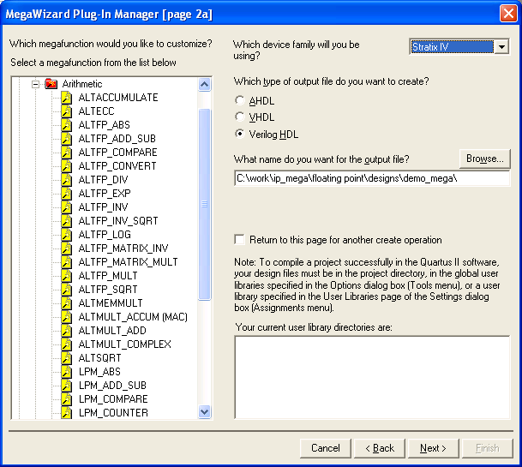
Quartus II Software: MegaWizard™
Plug-In Functions
Notes:
The floating point Megafunctions are available within Quartus, as shown.

Slide 25
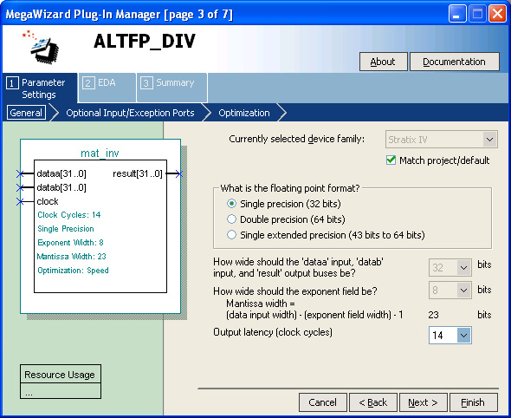
Single, Double, or Extended Precision
Single, Double, or, Extended Precision*
* Matrix Inversion = Single Precision Only
Notes:
Many floating point Megafunctions are available in multiple precisions – single, single extended, and double.
Some of the more complex Megafunctions, such as matrix inversion, FFT and trigonometric functions are available in single precision only however.

Slide 26
Complex Functions Run almost as fast as Multiply and Add
Function | ALUTs | Register | Multipliers (27x27) | Latency | Performance
ALU | 541 | 611 | n/a | 14 | 497 MHz
Multiplier | 150 | 391 | 1 | 11 | 431 MHz
Divider | 254 | 288 | 4 | 14 | 316 MHz
Inverse | 470 | 683 | 4 | 20 | 401 MHz
SQRT | 503 | 932 | n/a | 28 | 478 MHz
Inverse SQRT | 435 | 705 | 6 | 26 | 401 MHz
EXP | 626 | 533 | 5 | 17 | 279 MHz
LOG | 1,889 | 1,821 | 2 | 21 | 394 MHz
Little difference between add/subtract and common Math.h functions
CPU can Have 100 of Cycles per Complex Function: GOPS ≠ GFLOPS
Stratix Series FPGAs:GOPS ≈ GFLOPS
Notes:
Here are performance and resources usage of several floating point Megafunctions in Stratix IV.
Not only are the functions high performance, or Fmax, but notice that the more complex operators, such as inverse square root, require similar resources as a floating point adder. This means that these type of functions can be used as frequently as necessary.
By contrast, in CPU and GPUs, might use hundreds of cycles for these operators, or hundreds of times the processing “cost” of a simple floating point multiplier or adder. Clock cycles in a CPU are analogous to logic resources in an FPGA.
So in FPGAs, FP operators, even complex, equate simple floating point functions in CPUs.

Slide 27
Matrix Megafunction Performance
Matrix Multiply Core | Adaptive Logic Modules | 18x18 Multipliers | Performance (Stratix IV FPGA)
(36x112) x (112x36) | 4,604 | 32 | 291 MHz
(64x64) x (64x64) | 13,154 | 128 | 292 MHz
(128x128) x (128x128) | 25,636 | 256 | 293 MHz
Matrix Inversion Core | Adaptive Logic Modules | 18x18 Multipliers | Performance (Stratix IV FPGA)
8x8, vector size 8 | 6,189 | 63 | 312 MHz
16x16, vector size 16 | 10,024 | 95 | 305 MHz
32x32, vector size 32 | 19,313 | 159 | 287 MHz
64x64, vector size 64 | 31,658 | 287 | 221 MHz
Notes:
Here are benchmarks of very large Megafunctions, composed of hundreds or thousands of individual floating point operators. Notice on the matrix multiply benchmarks, that as larger and larger matrices are used, the Fmax remains constant. This is proof that Fused Datapath is scalable across an entire FPGA device.
Matrix inversion is one of the most difficult functions algorithmically. It is used in many applications in radar, wireless, test equipment and wherever multiple equations must be solved simultaneously. It requires large dynamic range, hence the need for floating point numerical processing.

Slide 28
Fast Fourier Transform (FFT) Performance (Stratix IV FPGA)
FFT MegaCore Device: EP4SGX530 | 14 Floating-point FFT cores, 1,024 pt
 | Usage | Max | %
Logic utilization | 301,308 | 424,960 | 71
ALUT | 230,974 | 424,960 | 31
Reg | 215,499K | 424,960 | 28
M9K | 1,280 | 1,280 | 100
M144K | 64 | 64 | 100
DSP block 18-bit | 896 | 1,024 | 88
f_{MAX} | 302 MHz
Transform time per core | 3.4 us (normalized: 0.24 us)
40 nm Stratix IV FPGA: ~1W per Floating-Point FFT Core
Stratix V FPGA will Have Half the Power of
Stratix IV FPGA Implementation
28
Notes:
28
Here’s a floating point FFT benchmark. Using the Altera FFT Megacore incorporating fused datapath, the customer performed a study comparing Pentium processor based FFT throughput to FPGA based. The FPGA won handily, and the results are shown on the left. A total of 14 single precision FFTs were implemented in a Stratix IV FPGA. The design closed timing at over 300 MHz, with a 71% full device. This definitely demonstrated the ability to fill a large device with floating point circuits, and still efficiently rout the design. The dynamic power consumption was about 1 Watt per FFT, or 14 Watts in this case.
With Stratix V, power consumption is expected to be about ½ that of Stratix IV.

Slide 29

Thank You
Notes:
Thank you

