Slide 1
What’s New in Quartus II Software v11.0—
General Overview
Jun 2011

Slide 2



Quartus II Design Software
Everything you need to design for Altera programmable logic devices
The #1 design software for performance and productivity
The only complete development package supporting FPGAs, CPLDs, and HardCopy ASICs
CPLDs
FPGAs
HardCopy ASICs
SoC
Notes:
We refer to Quartus II as a fully integrated design tool because you can do everything you need to do to create an FPGA design within the Quartus II software without the need for any other tools. The Quartus II software gives you the ability to enter your design in multiple ways. Once entered or created, the software will then synthesize your design into logic and place & route your design using the resources of your target device. You can perform logic simulations and timing and power analyses all within the Quartus II software environment. You can then use the built-in programmer to program an FPGA device with your design.
The Quartus II software is available for multiple operating systems with multiple licensing options. You can have a license locked on a particular machine, or you can use a license server to distribute licenses among multiple workstations. This versatility makes it easy to integrate Quartus II into your work environment.

Slide 3
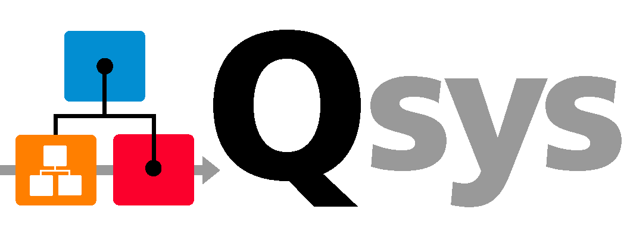

Quartus II v11.0 Highlights
Stratix V updates
  Expanded transceiver modes and features support
Qsys system integration tool - Production release
  High-performance interconnect
  Hierarchy support
  Simulation and testbench support
Enabling faster transceiver design and verification
  Improved Chip Planner view
  Transceiver Toolkit usability enhancements
Extending leadership in external memory interface design and debug
  New high performance memory controllers
  New performance monitoring feature in External Memory Interface Toolkit
DSP Builder on 64-bit Linux and Windows platforms
Notes:
Here are the highlight for 11.0, there are update to the Straix V device family, there are new device members as well as new pin outs available. The qsys system integration tool will be introduce for the first time as production release, it has support for hierarchy, high-performance interconnect, as well as simulation and testbench generation. On the transceiver design side, we are enabling faster verification and design of transceivers with improve chip planner view of the transceiver blocks as well as enhancement to the usability of the transceiver toolkit. On the external memory interface side, we are introducing new features in the external memory interface toolkit, and new performance monitoring capability is available in 11.0. We also make some enhancement to the memory controller Ips. On the DSP builider side, we are having support for 64bit linux as well as windows platforms.

Slide 4
Device Family Support
Notes:
Let’s first begin with the Device Family support updates

Slide 5

Improved Stratix V FPGA Support
Expanded transceiver modes
  GigE, SDI
Expanded transceiver features
  Receiver offset calibration
  Linear equalizer
  Dynamic reconfiguration of PMA analog settings
Stratix V FPGAs: Built for Bandwidth
Notes:
There are new transceiver mode support on Stratix V, specifically GigE, SDI, SDI single rate for SD/HD/3G, 10G SDI are available in 11.0. Enhancement to the transceiver features include receiver offset calibration, linear equalizer, and dynamic reconfiguration of PMA analog settings.

Slide 6


Cyclone IV FPGAs & MAX V CPLDs
Cyclone IV GX FPGA support
  Final timing models for all devices
  POF support available for all devices
MAX V CPLD support
  Automotive device support includes new -5A speed grade
  POF support available for all devices
  Final timing and power models for all devices
  For more information, visit the MAX V Device page
Notes:
Let’s now take a look at some of the update on our Cyclone IV GX FPGA and MAX V CPLD device family.
For the Cyclone IV GX FPGA, we have final timing models support, as well as POF support for all Cyclone IV GX FPGA device family.
Lastly on the device support section of this presentation, we will now take a look at the updates for the MAX V family. In version 11.0, we will have automotive support for the A5 speed grade for the MAX V CPLDs. In addition, we will have final timing and power model available for the MAX V devices.

Slide 7
Qsys System Integration Tool
Notes:
Let’s now take a look at the new software features and design flow that are available on version 11.0. We will begin with the Qsys, next generation system integration tool.

Slide 8
Feature Summary in v11.0 – Production Release
High-performance interconnect (Network-On-Chip)
  Implementation optimized for FPGA architecture
Hierarchical system design
  Enable the creation of scalable systems
  Facilitate team-based designs
Design reuse
  Reuse Qsys systems within other Qsys systems
  Enable fast system-level integration of Qsys compliant IP
System verification
  Simulation
  System debug
Notes:
Here is the quick summary of the features in version 11.0 for Qsys. There is a network on chip interconnect available that’s been optimized for FPGA architecture. Hierarchy support for system design, and it is enable to making your design easier for scalability to add IP as well within your subsystems and reuse Ips for future projects as well as projects within your own organizations and divisions. In addition, in system verification, there is the ability to do simulation as well as system debug by instrumenting and monitoring signals and performance of the overall system to fine tune it to get optimizations for your overall system performance.

Slide 9

1. Qsys - Interconnect Performance (1 of 2)
Up to 2X higher performance compared to the SOPC Builder system interconnect fabric
Qsys interconnect is based on the Network on a Chip architecture and supports automatic pipelining
Peripheral
Qsys Interconnect
(Based on NoC Architecture)
Peripheral
Peripheral
Peripheral
med
low
high
off
Notes:
First, interconnect performance.
With Qsys, you can increase your performance up to 2x from SOPC Builder based on a new network-on-chip architecture and automatic pipelining feature for more intelligent interconnect. <click next>
In Qsys, the automatic control will generate automatic pipeline stages. The flexibility of the Qsys interconnect, based on a network-on-chip architecture, enables Qsys to automatically insert pipeline registers into the interconnect to achieve nearly double the fmax performance compared to SOPC Builder. <click next>
Then, to further optimize performance, there is a user-controlled dial that allows you to increase performance by trading off latency. As you increase performance, pipeline stages are added into the interconnect.
<click next>
<click next>
Qsys allows you to make trade off decisions between fmax and latency to meet the system requirements of your end application and has interconnect performance up to 2x compared to SOPC Builder.

Slide 10
1. Qsys - Interconnect Performance (2 of 2)
White Paper: Applying the Benefits of Network on a Chip Architecture to FPGA System Design
Increased f_{MAX} Performance (%)
Qsys Interconnect Delivers Higher Performance
Notes:
I also want to quickly reference to a published Qsys white paper with a design example for performance benchmark data. Please reference to this Qsys white paper named “applying benefits of network on a chip architecture to fpga system design” for more details.
This design example is built with 16-master/16-slave and performance results. This data shows Qsys interconnect performance is up to 2X faster than SOPC Builder interconnect with 4 cycle network latency.

Slide 11
2. Hierarchical Design
Hierarchical system design is now supported
  Enables the creation of scalable systems
Subsystems act like components
  Versioning
  Documentation linking
  Component grouping e.g. memory
  controllers, processors
Benefits
  Easier to create and understand large hierarchical systems
  Facilitates team-based designs
  Enables you to reuse Qsys systems within other Qsys systems
subsys.qsys
On-chip
memory
Processor
Bridge
Bridge
Data
processor
0
Data
processor
0
Notes:
Lets move to another important feature that supports more scalable design. The higher the number of components, the slower the GUI….and it becomes a challenge to manage your system (for example editing and changing parameters for a large SOPC Builder system with 200 components). Qsys enables hierarchical design, so you can create small sub-systems and integrate them together to create a larger system.
Qsys supports developing hierarchical systems by enabling you to complete a system today, and in the future, add an entirely new sub-system. By dividing a system into different sub-systems with hierarchy, you can easily manage each sub-system. Also it will make it lot easier for versioning, documentation linking, component grouping e.g memory controllers, processors grouping.
The benefits it bring includes easier to create and understand large hierarchical systems, facilitates team-based designs, and enables you to reuse Qsys systems within other Qsys systems

Slide 12
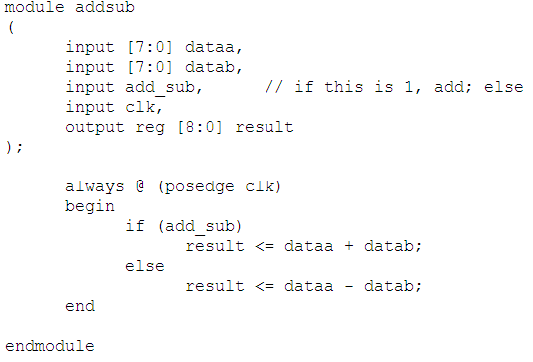
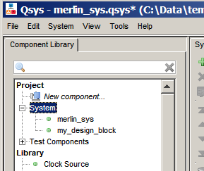

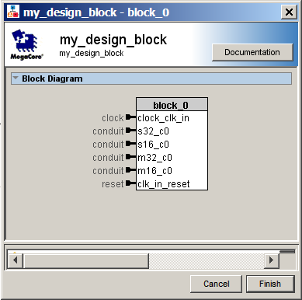

3. Qsys: Design Reuse Flow
my_design_block
1. Import your design
Qsys provides a component editor
tool to import your RTL design
2. Qsys creates IP
Automatically packages your design
Automatically promotes your design
3. Reuse with other Qsys systems
Packages
and
Adds to Library
System A
Syatem B
IP GUI Wizard
Uses Library Path
Notes:
Step 1, Import your verilog or vhdl design into Qsys using the provided component editor.
<Click>
Once imported Qsys will automatically package up your design block with a GUI wizard so it appears like any other Qsys compliant IP. At the same time Qsys will add your design block into the component library within Qsys.
<Click>
Finally the third step is for you or other designers to add your design into their systems. For example here both System A and System B is using your design block they found from the component library in Qsys

Slide 13
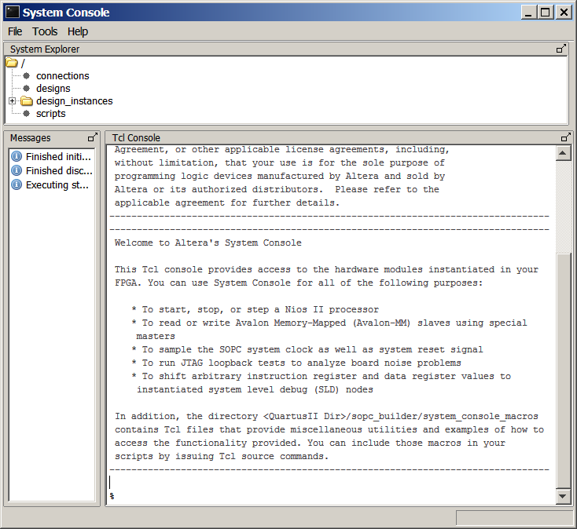
4. Verification Challenge (On-Chip Debug)
On-Chip Debug
  Time consuming to tap 100’s of registers and analyze large amounts of data
Qsys accelerates verification with read and
write transactions
  Read and write to registers and memories instead of tapping each
  individual registers
System Console
FPGA
A
Bridge
IP
View Data
in Real-Time
JTAG Bridge IP
TCP/IP Bridge IP
B
C
D
Faster Board Bring-Up with Real-Time
System Debug
Notes:
Qsys also supports onchip debug to help you debug your system in real-time.
Qsys allows you to access the system by sending read/write transactions through a bridge IP. In this example, the bridge IP (it can be JTAG or a TCP/IP bridge) enables your system to be accessible by system console available from within qsys. You can then write test vectors into your system and read back the data.
Remotely reading and writing into your system can be much more efficient than accessing each individual register.

Slide 14
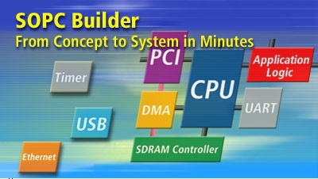
Qsys as a Platform for System Integration
Both Qsys and SOPC Builder tools are available in v11.0
New IPs / new FPGA families are only supported in Qsys
  Altera recommends that you use Qsys for new designs
Notes:
In version 11.0, both Qsys, which is next generation of system integration tool, as well as it’s predecessor, the SOPC builder tool will be available in Quartus. Moving forward, and alone with version 11.0 any new Ips that are developed by Altera or our partners, and any new FPGA family that are supported in Quartus II will only be supported in Qsys and not in SOPC Builder. So our recommendation is for you to begin any new design using Qsys instead of SOPC builder

Slide 15
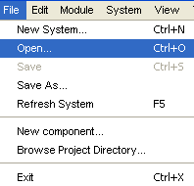
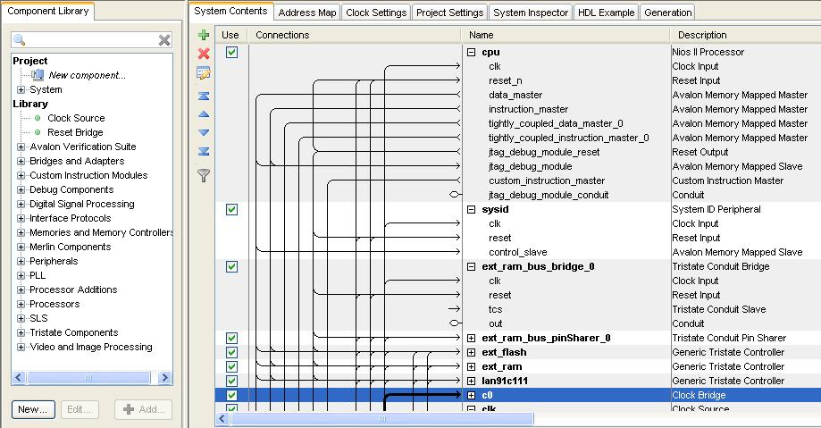
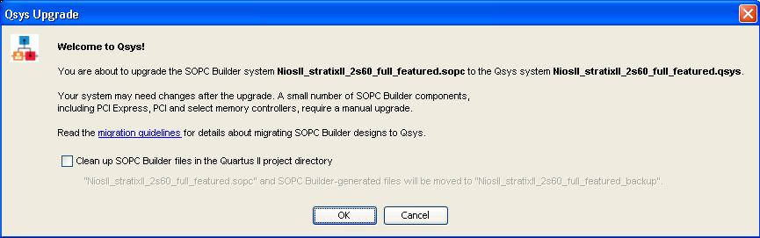
How to Start: Switch to Qsys
Step 1: open existing SOPC Builder system
  Qsys is backward compatible with .sopc file
Step 2: save design file
  Automatically convert files to Qsys design files
Step 3: follow the guideline in Qsys migration application notes and release note.
Open File
Qsys Migration Dialog
Familiar GUI in Qsys
Notes:
In the migration online demo, it shows you how to get started with switching to Qsys. There are two simple steps. First, you simply open an existing SOPC Builder system. Qsys is backward compatible with .sopc file and you will be promoted with a migration dialog box. Click ok to proceed and you will find your existing SOPC Builder system ported to Qsys in a familiar GUI environment.
Then, you can save your design file in .qsys to finish .sopc file conversion to .qsys file. Be aware of the manual steps you have to go through mentioned in Qsys migration application note and release note. I hope you find Qsys migration intuitive and please share with us your successful migration and performance enhancement in Qsys.

Slide 16
Additional Productivity Features
Notes:
Let’s take look at what are additional productivity features version 11.0 brings to us

Slide 17
Elaborate Hierarchy and Design Entry Enhancement
Notes:
First is the Elaborate Hierarchy and design entry enhancement

Slide 18
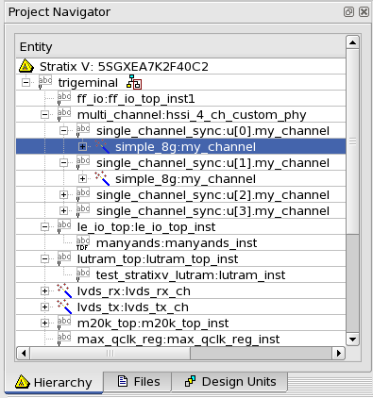
Elaborate Hierarchy Flow
This new feature enables you to quickly understand your design’s hierarchy without requiring to run analysis and synthesis
  Facilitates design partitions creation and assignments
  ~40 % faster runtime compared to a full synthesis (i.e. quartus_map)
Command-line option to elaborate the hierarchy of the design
quartus_map – elaborate_hierarchy <top_level name>
Notes:
In 11.0 there is a new flow that is available for you, it is called elaborate hierarchy. If you are building a design and you want to see your design hierarchy so that you can begin to make design partition assignments, this is a good flow to use. You can see a reduction of 40% runtime as compare to running a full synthesis. This flow, elaborate hierarchy is only available in command line in version 11.0. It is call quartus_map – elaborate_hierarchy and entering your top level name.

Slide 19
HDL Design Entry
Quartus II software has a powerful, comprehensive integrated synthesis solution built into the software
  Supports VHDL, Verilog, and SystemVerilog
    Extensive support of language coverage
    Allows users to describe the RTL in HDL language of choice
Enhancement in v11.0 includes:
  Expanding SystemVerilog support
    Export tasks and functions from interfaces
    Increased number of templates to help you get started with your design entry
  Expanding Verilog support
    Enhanced $readmemb/$readmemh to have the filename defined by parameter as compared to the absolute path
  parameter ram_file = “ram.txt”
  reg [7:0] ram[0:15];
  initial
  begin
  $readmemb(ram_file, ram);
  end
Notes:
If we take a look at what we have done in the HDL design entry enhancement in version 11.0. We have support in exporting task and functions from interfaces in system verlog. Those functions are available from the interface definitions. In addition, we have also added some new templates that will help you to begin your design entry with system verilog.
On the verilog support side, we enhanced the readmemb and readmemh, so that you can define the file name by parameter as compared to have to write the absolute path. Here is an example, I shown here in the bottom, now the memory content file can be essily modified at the command line or at the top level of your design by changing the parameter value

Slide 20
Transceiver Design and Verification
Notes:
Let’s now take a look at some of the transceiver design and verification enhancement for 11.0

Slide 21
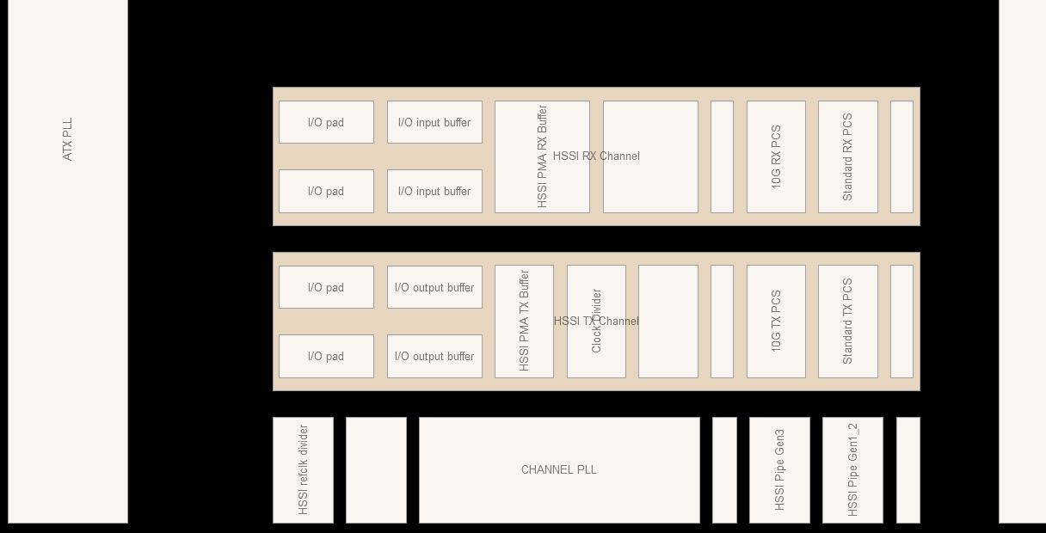
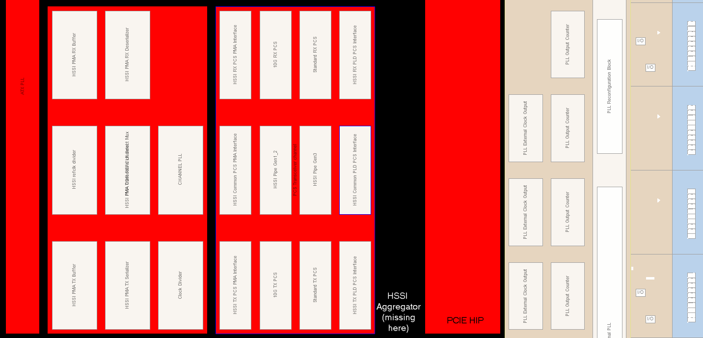
Chip Planner – Stratix V HSSI Enhancements
v11.0
Improved usability when designing and verifying Stratix V FPGA transceivers
  RX and TX channels distinctly visible
  Blocks arranged according to data-flow
  Important blocks displayed prominently
  Assign the PLLs across all channels
v10.1
Notes:
If you ever have to verify the implementation of the transceivers, in 11.0, this will be lot easier for you in chip planner. We had made some of the modifications to the view of the transceiver blocks so that you can see the RX and TX channels more distinctly, also the block had been arranged to identify the data-flow whether it is receiver or transmitter. Also you will be able to assign PLLs across all channels

Slide 22
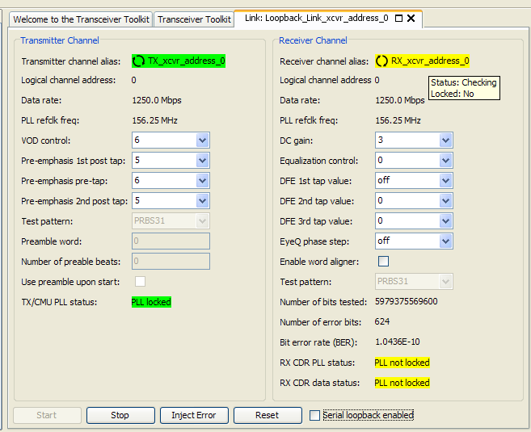
Transceiver Toolkit Enhancements
Improved control panel for ease of use
  Unified view and control of transmitter and receiver channels
  Reporting additional data
    e.g. channel data rate, reference clock, lock status
  Visible status indicators
    Color and animation
  Serial loopback control option
Notes:
We introduce the transceiver toolkit in 10.0, we made some enhancement in 10.1, and we make some more enhancement in 11.0.
In 11.0, the primary enhancement are on the usability. It should show you a more clear view of the status of what is happening in the transceiver links, whether or not the PLL or the CDR had been locked. It also will give you a view of both the transmitter and receiver channels under one tap, so that you can quickly control the transmitters and receivers using this one view. In addition, we will have more information that are reported, including the channel data rate, the reference clock, as well as the lock status as I mentioned earlier. Also, probably the first step in debugging your transceiver signal quality and performance is to be able to do a serial loopback. With 11.0, you can easily enable the serial loopback option.

Slide 23
Programming and Configuration
Notes:
Let’s now take a look at some of the enhancement in the programming and configuration section

Slide 24
Programming and Configuration Enhancements
Quartus II Programmer supports
Enhancement in v11.0 includes:
  PFL NAND flash improvements
    Added JAM programming support
    Added Micron MT29 1Gb support
      X8 mode
  Updated Active Serial Memory Interface (ASMI) parallel Megafunction and MegaWizard
    Added Stratix V support
      Dual and quad data modes
Mode | FPGA | CPLD | Config. Device | Serial Config. Device
JTAG | √ | √ | √ | −
Passive Serial (PS) | √ | − | − | −
Active Serial (AS) | − | − | − | √
In-Socket Programming | − | √ | √ | √
* For more detailed, please refer to Quartus II Programmer chapter in the handbook
Notes:
For the PFL or the parallel flash loader IP, we had made some improvement on the NAND flash support. We had added the programming support using JAM. We had also added support for the Micron MT29 1Gb device, it is available by 8 mode.
On the active serial memory interface or the ASMI parallel megafunction, we had added support for Stratix V. This will have support for both the dual and quad data modes

Slide 25
External Memory Interface Design and Debug
Notes:
25
We will now place our attention to the external memory interface design and debug section

Slide 26
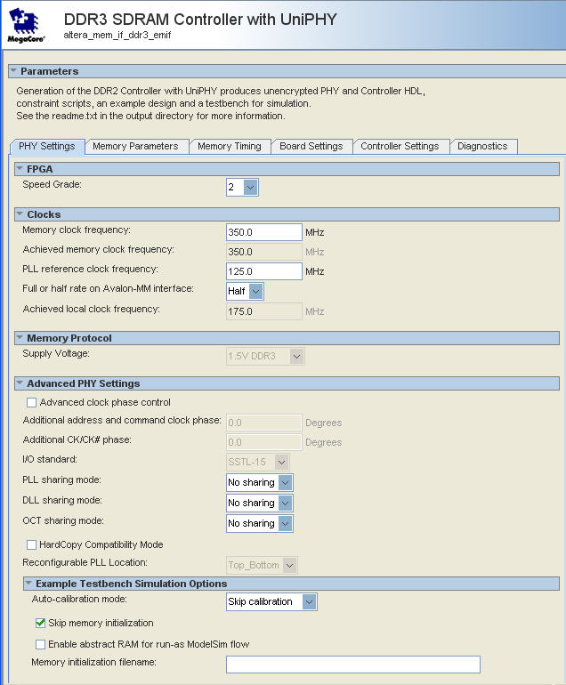
v11.0 HPC II – Feature Enhancements
Supports DDR2/DDR3 with UniPHY and ALTMEMPHY
  Stratix V is only supported on HPC II with UniPHY
Feature enhancements
  Data re-ordering support with option to disable
  Sub-word write without data mask (DM) pins
  CSR support is backward compatible with v10.1
Notes:
For the high performance memory controller support in version 11.0, there are some feature enhancement that are available. First of all, DDR2 and DDR3 are supported with both UniPHY and ALTMEMPHY variants. However, Stratix V is only supported on HPC II with UniPHY.
As far as enhancement, there is data re-ordering support with the option to disable. We also have support for the sub-word write without data mask pins. The CSR support is backward compatiable with version 10.1.

Slide 27
Abstract UniPHY for Faster Simulation
New option to enable faster simulation
  Expect 2-10x speedup in PHY simulation time
  Speedup depends on specific configuration and interface width
Supported for all protocols and FPGA device families
Abstract models always perform in “skip calibration” mode
  Results are cycle accurate, and not sub-cycle accurate
  Both Verilog and VHDL support abstract models
  Abstract model is the default
  Use +define+ option in ModelSim to select detail models
    Verilog support only
+define+ALTERA_ALT_MEM_IF_PHY_FAST_SIM_MODEL=value
where value = 0 to enable the detail (slower) model
  1 is the default, enabling the abstract (fast) model
How?
  Real PHY needs to closely model details of individual I/Os blocks
  “Abstract” PHY can combine details into wider buses and fewer stages
Detailed Single-bit Style
Abstract Vector Style
Notes:
When simulating the external interface using UniPHY, we had enable an option to make the simulation faster. You can expect 2 to 10 times faster simulation of the PHY, the speedup depends on specific configuration and interface width. All protocol and device famliy are supported with this faster simulation option. The abstract models always perform in “skip calibration” mode, the result are cycle accurate, and it does suppport both verilog and VHDL. The option to enable this faster simulation is to use the define option in modelsim to select the detail models. So I shows here you will chose the define ALTERA ALT MEM IF PHY FAST SIM MODEL with the value one for enabling the faster model, if you would like to run the slower model, you will set the value to zero. We are able to provide a faster simulation model by combining the details into wider buses and fewer stages to a simulation, where as the previous model or the slower model, it models the details of the individual I/O blocks

Slide 28
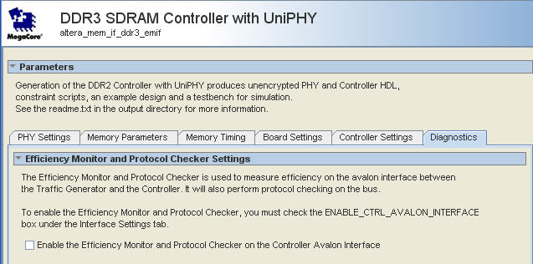
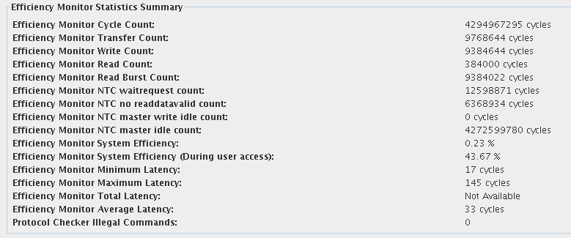
External Memory Interface Toolkit – Performance Monitoring
Efficiency monitor statistics
  Report all internal counters and computed values
    e.g. system efficiency and average latency
  Display protocol checker status
Diagnostics tab in high performance memory controller MegaWizard
  Turn ON option
Launch External Memory Interface Toolkit
  Quartus II → Tools menu
Notes:
With the external memory interface toolkit in version 11.0, we are providing a new performance monitoring capability. With this feature, you will be able to monitor the statistics in the memory controller. Information such as the system efficiency, and average latency, can be provided, it also displays the protocol checker status. This is useful information when you are trying to fine tune your system for your external memory interface. To enable this capability, in the MegaWizard you will need to turn on the option as shown in the diagnostic tab. From there you will be able to launch the external memory interface toolkit from the Quartus II tools menu. By doing that, you will be able to see the performance monitoring information in the toolkit

Slide 29
DSP IPs
Notes:
Let’s now turn our attention to the DSP IP enhancement in version 11.0

Slide 30
What’s New in DSP for v11.0
FIR Compiler II MegaCore
  Support for Stratix V, in particular systolic FIR filters
FFT MegaCore
  Optimized for Stratix V
    GUI option to minimize resources or maximize performance
Reed Solomon II Encoder and Decoder
  10 Gbps reference design now available
Floating Point Megafunction
  New Arc-Tangent Megafunction (single precision only)
Enhancements to video and image processing (VIP) suite
  New Megafunction: Scalar II (This is HDL based)
  Qsys simulation support
DSP Builder Advanced Blockset
  64-bit support in Linux and Windows platform
  Additional floating point optimizations – folding, QoR
  Stratix V optimizations – example, systolic FIRs
Notes:
In version 11.0, the FIR compiler II MegaCore will support for Stratix V, specifically for systolic FIR filters
The FFT MegaCore has been optimized also for Stratix V, there is also option in the GUI to minimize the resource or to chose the maximum performance.
The Reed Solomon II Encoder and Decoder has a 10Gbps reference design that is available.
For the floating point Megafunctions, there is a new arc-tangent megafunction for single precision available.
The VIP or the video imaging processing suite, has enhancement to the Qsys simulation support as well as adding a new megafunction for the scalar II. This is now HDL based.
The DSP Builder advanced blockset will have 64bit support in the Linux and Windows platform. In addition, there is floating point optimizations including folding, as well as improvement on the quality of results. There also been optimzations to Stratix V, example for this is for the sysolic FIRs

Slide 31
DSP Builder Setup Script
DSP Builder - Linux platform only
  Linux DSP Builder setup now relies on setup script
    dsp_builder.sh script is in the DSP Builder install directory
    Use this script to startup MATLAB
  No longer create/update these files in your HOME directory
    startup.m and .matlab7rc.sh
Notes:
For DSP Builder in the Linux platform, there is a dsp_builder.sh script that is in the DSP Builder install directory, please use the script to startup MATLAB. You should not longer have to create or update the startup.m as well as the .matlab7rc.sh in your home directory

Slide 32
Quartus II v11.0 Highlights
Stratix V updates
  Expanded transceiver modes and features support
Qsys system integration tool - Production release
  Hierarchy support
  High-performance interconnect
  Simulation and testbench support
Enabling faster transceiver design and verification
  Improved Chip Planner view
  Transceiver Toolkit usability enhancements
Extending leadership in external memory interface design and debug
  New high performance memory controllers
  New performance monitoring feature in External Memory Interface Toolkit
DSP Builder in 64-bit Linux and Windows platforms
Notes:
Here is the quick summary again, of the 11.0 hightlighs.
In Stratix V we have new devices which available as well as finalized pinouts.
For the first time, in the quartus II 11.0, we are introducing the qsys production release. Qsys has support for Hierarchy, High-performance interconnect, as well as simulation and testbench capabilities.
For the transceiver design and verification, we have a new improved chip planner view of the transceiver blocks, as well as some usability enhancement for the transceiver toolkit.
On the external memory interface design and debug, the new high performance memory controller II has new capabilities for supporting Stratix V as well as performance monitoring capbilities in the external memory interface toolkit.
Lastly, the DSP Builder support in 64bit Linux and Windows platforms

Slide 34
Transceiver Mode Support
PCIe Gen1 and Gen2 | ✓
XAUI (soft PCS) | ✓
10GBase –R | ✓
10GBase –KR | ✓
Interlaken | ✓
40G Ethernet (10G custom) | ✓
100G Ethernet (10G custom) | ✓
SFI-S (10G custom) | ✓
SFI-5.1 (8G custom) | ✓
10G GPON/EPON (10G custom) | ✓
GPON (8G custom mode) | ✓
GIGE (using LVDS) | ✓
GIGE (using transceiver) | 11.0
SGMII | ✓
SDI (8G custom) | 11.0
SDI (single rate SD/HD/3G) | 11.0
10G SDI (10G custom) | 11.0
JESD204A (custom mode) | 11.0
SerialLite II (8G custom) | ✓
FC 1/2/4/8 (8G custom) | ✓
SONET (8G custom) | ✓
34
Notes:
34

Slide 35
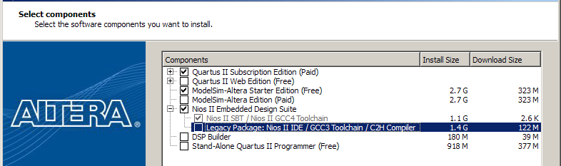
Download and Installation
Available online at www.altera.com/download
  DVD available on request www.altera.com/dvdrequest
Nios II Embedded Design Suite (EDS) now ships with Quartus II v11.0
  Starting v11.0, Nios II IP and Nios II Software Build Tool (SBT)/GCC4 toolchain are included in the Quartus II software installation process
    For subscription and web edition software
  If you wish to use Nios II IDE software
    Install the “Legacy package: Nios II IDE / GCC3 Toolchain / Nios II C2H Compile”

Slide 36
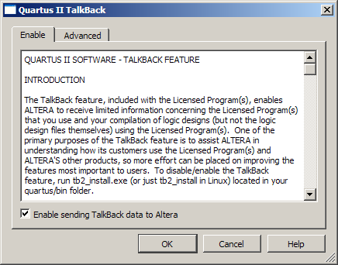
Quartus II Software Web Edition
Features that are not included:
  Multiprocessor support
    Pay for compile-time performance
  Incremental compilation
  SSN analyzer, Transceiver Toolkit, and external memory interface toolkit
  HardCopy tools
Enable TalkBack feature to use:
  SignalTapTM II logic analyzer
  SignalProbe feature
Turn on TalkBack by clicking
TalkBack Options button in
Tools | Options | Internet Connectivity
Quartus II Software
Subscription Edition and Web Edition
Feature Comparison Available on altera.com

Slide 37
SOPC Builder to Qsys Migration Flow
Reset connectivity
  Migration of SOPC Builder design connects all resets together to preserve original design intent
    Always global reset network in SOPC Builder
  User has the following options:
    Option available from System Menu: System -> Auto-Connect Resets
    Or manually make reset connections for new components
Exported interfaces
  Migration from SOPC Builder design maintains exported interfaces
  Pin names set to match SOPC Builder conventions as closely as possible
User SDC files
  After migration from SOPC Builder, any references to SOPC-specific node names required manual edit to the SDC file
Simulation changes
  You can now edit your Qsys testbench as a Qsys system

Slide 38
Qsys Changes From SOPC Builder
Native addressing is not supported
  All natively addressed slave interfaces are treated as 32-bit dynamic interfaces
    Nios II software drivers for existing natively address slaves will continue to work correctly
  Recommendation is to upgrade existing components to dynamic addressing
Unregistered tri-state inputs no longer supported
  Tri-state transform takes this into consideration when converting SOPC Builder systems and adjusts accordingly

Slide 39
High-Performance Controller II (HPC II) in v11.0
Re-architected UniPHY generation
  Qsys compliant and designed for future flexibility
  No RTL interface changes
  Note: There are changes to parameter names and hw.tcl interfaces
MegaWizard design flow
  v10.1 → v11.0 HPC II with UniPHY
    Must regenerate v10.1 UniPHY variants
  v10.1 → v11.0 HPC II with ALTMEMPHY
    No changes to existing designs
    Stratix III/IV device families are not supported
      Recommend using UniPHY
Qsys / SOPC Builder design flow
  v10.1 → v11.0 HPC II with UniPHY
    Manually create and enter settings
  v10.1 → v11.0 HPC II with ALTMEMPHY
    Same as MegaWizard design flow support

